Slide 1
ELAC
English Learner Advisory Committee
Academic Counselor: Ms. Patricia Murillo
Principal for JSHS: Ms. Leslie Marley
Principal for CMS: Mr. Steve Peters

Slide 2
¿What is ELAC?
Parents of EL students
Purpose: For parents to advise the school’s administration about programs and services for students
Opportunity for parents to receive advice and information on how to support their EL student

Slide 3
JSHS Staff - Administration
Principal: Leslie Marley Vice Principal: Allen Boltz

Slide 4
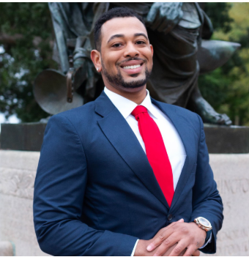
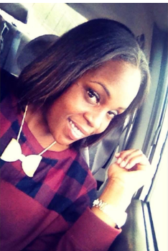
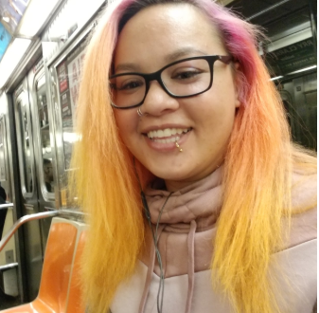
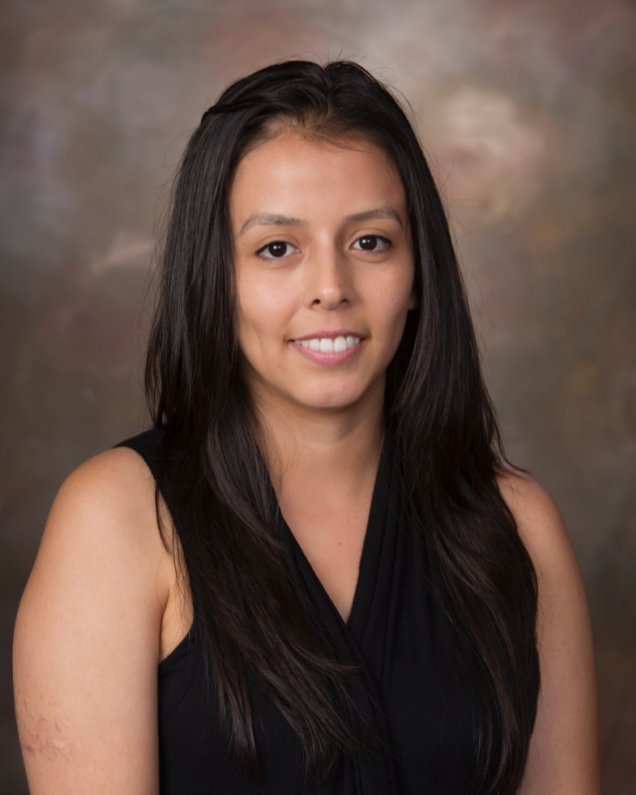
JSHS Staff - Counselors
Mental Health Academic Counselor
Wiley Rogers Tayari Carte Fidelia Ionyejekwe Kimchi Brooks Patricia Murillo

Slide 5
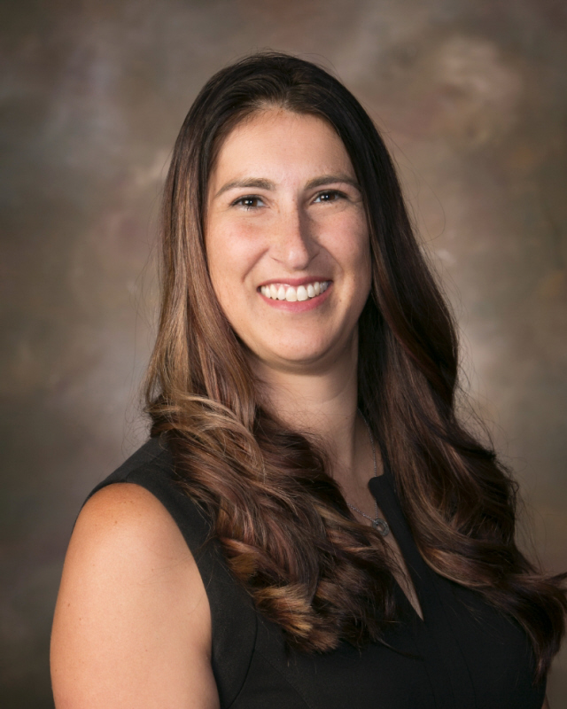
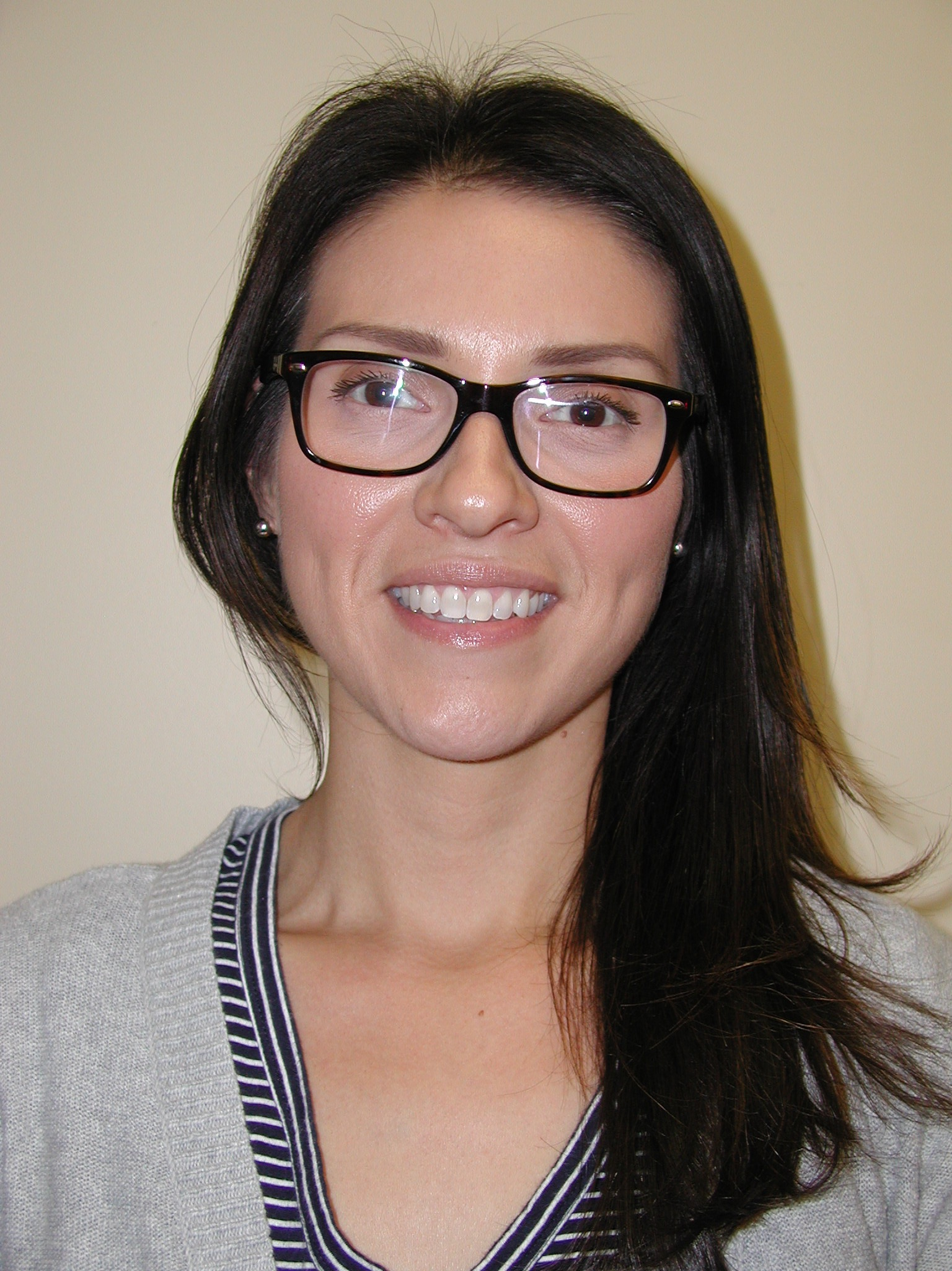
JSHS Staff - Office
Registrar: Attendance: ELD Teacher:
Erica Schlepp Celina Castillo Samuel Davis

Slide 6
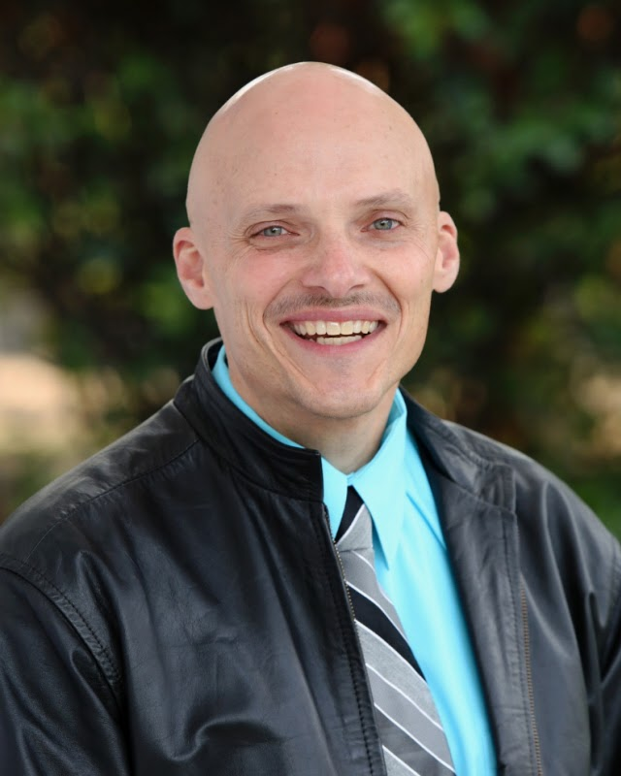
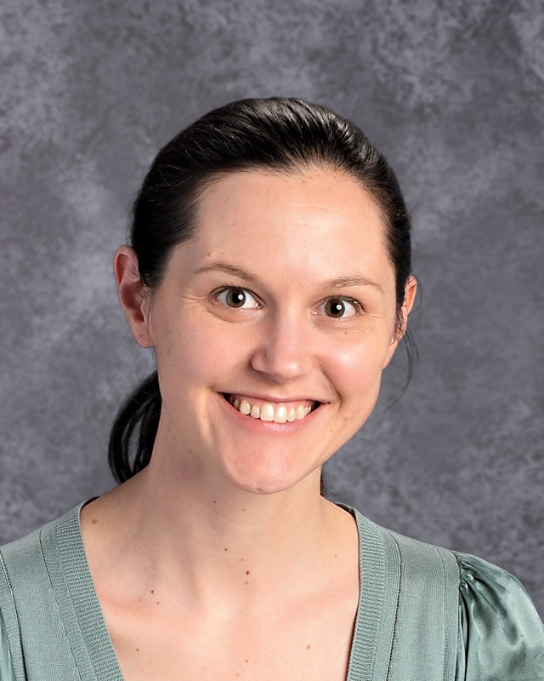
CMS Staff
Steve Peters Eden Kennedy-Hoffmann
Principal Teacher on Special Assignment

Slide 7
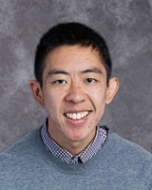
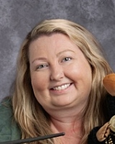
CMS Staff
Mental Health Counselors
Johnny Fang Kasey Wallace Angela Mendoza Ben Buckner

Slide 8
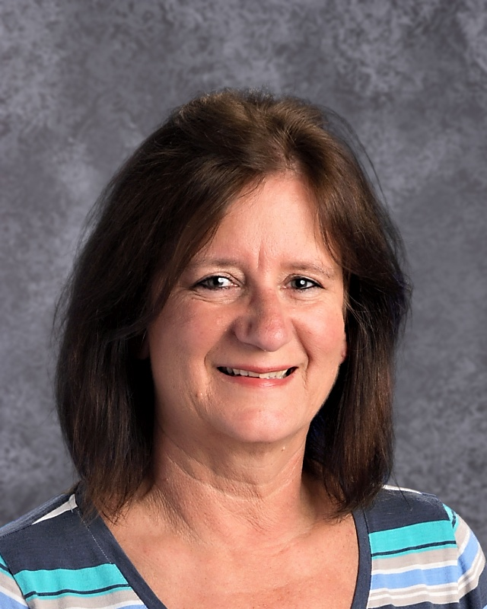
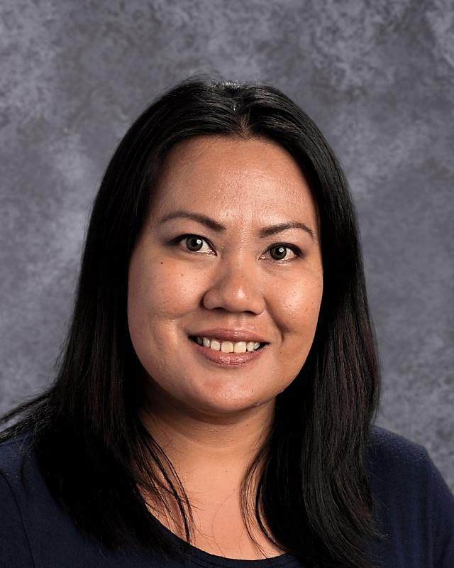
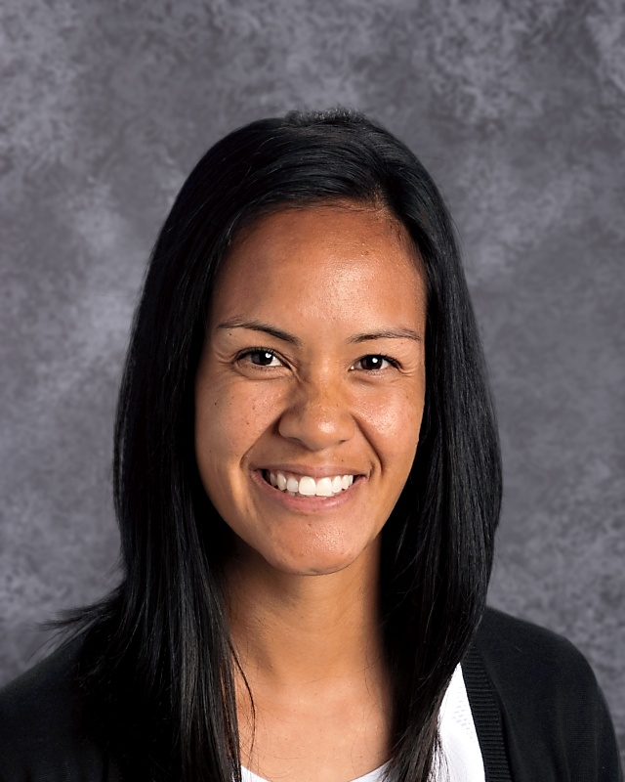
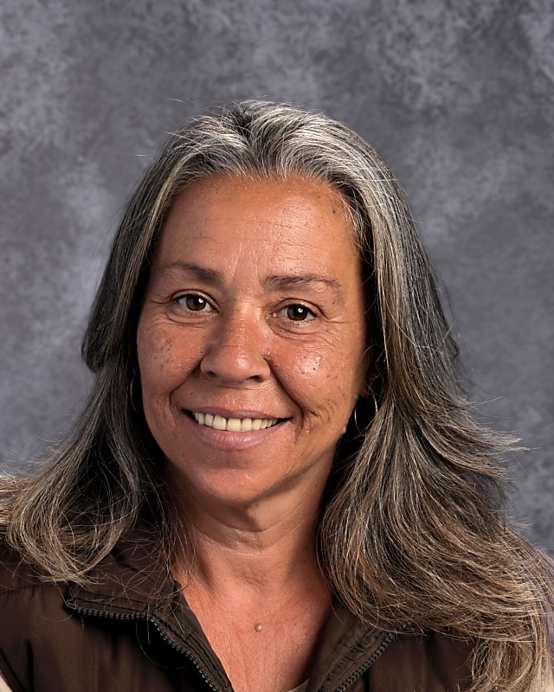
CMS Staff
Office:
Registrar: Attendance: ELD Teacher Bilingual Support
Annie Miller Cherryl Valenzuela Marilou Bibat Maria Ayala

Slide 9
Attendance - Its importance
Valid reasons to miss classes
Doctor appointment (call the school) - not for the whole day
Sickness
Death
Other emergencies
Reasons that are not so good:
Translation
To watch a sports game
Babysit
Other
Distance Learning (attendance)
Live classes
Non-live classes

Slide 10
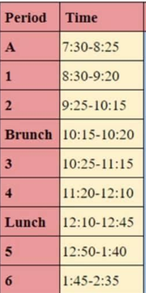
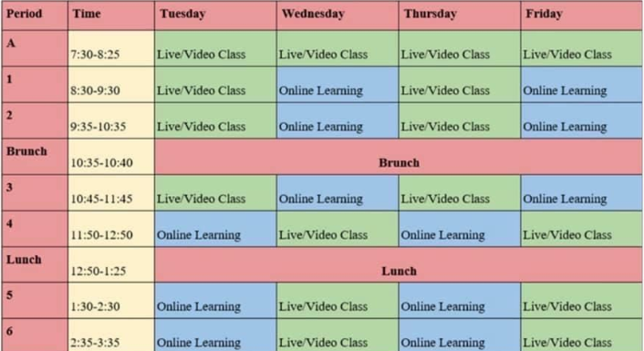
Distance Learning 2020 - JSHS
Google Classroom
Schedule available:
Monday schedule: Live check-in with 2nd period only. Attendance for all other classes are through Google Classroom

Slide 11
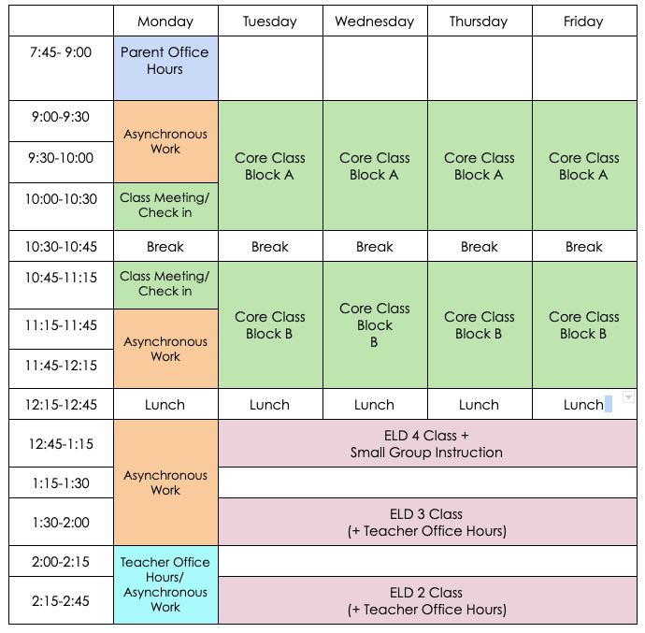
Distance Learning 2020 - CMS
There are 3 levels of ELD classes, which meet Tuesday-Thursday
ELD 3/4- 12:45-1:15
ELD 3 - 1:30-2:00
ELD 2/3 - 2:15-2:45
Teacher office hours, small group instruction, and asynchronous work also takes place after lunch

Slide 12
Communication
Concerns regarding :
Your child’s grade?
Mental health?
Graduation?
Behavior? Discipline?
How can you communicate?
Email, phone, text

Slide 13
Aeries
Attendance
Grades
Missing assignments
Help with creating your Aeries account

Slide 14
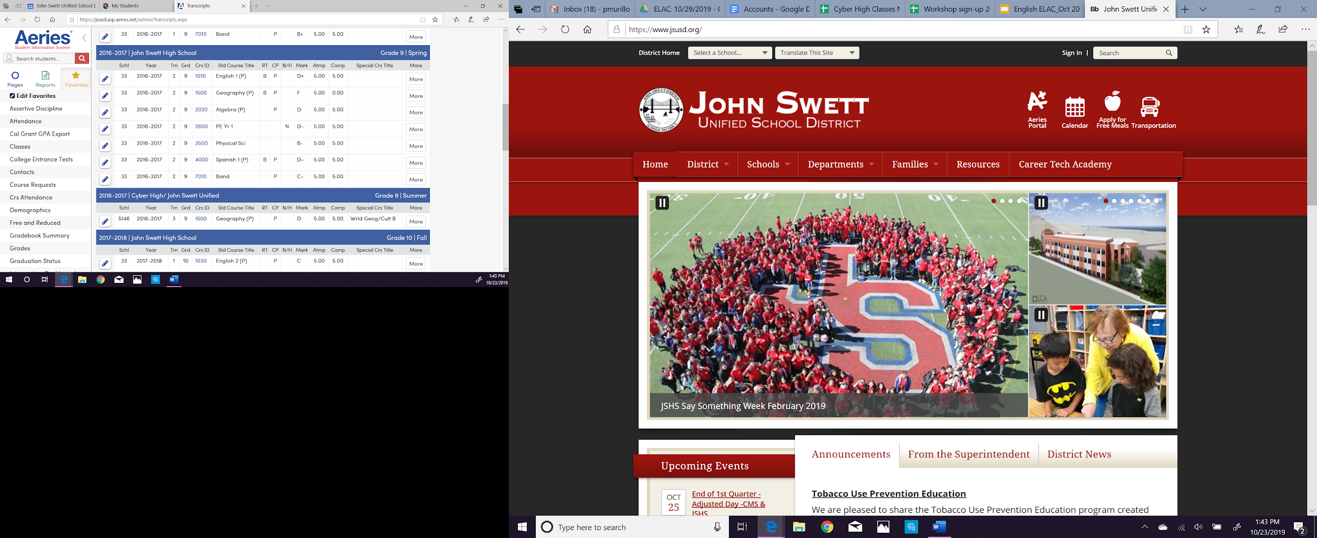
Aeries
Help with creating your Aeries account

Slide 15
Aeries
Help with creating your Aeries account

Slide 16
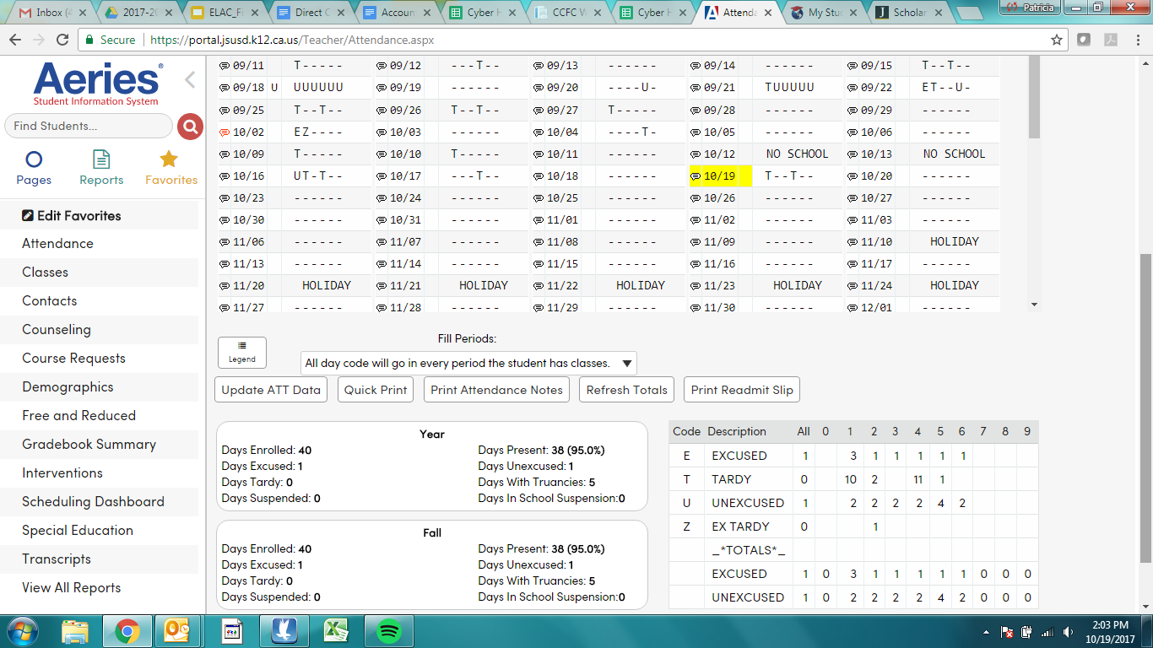
Aeries

Slide 17
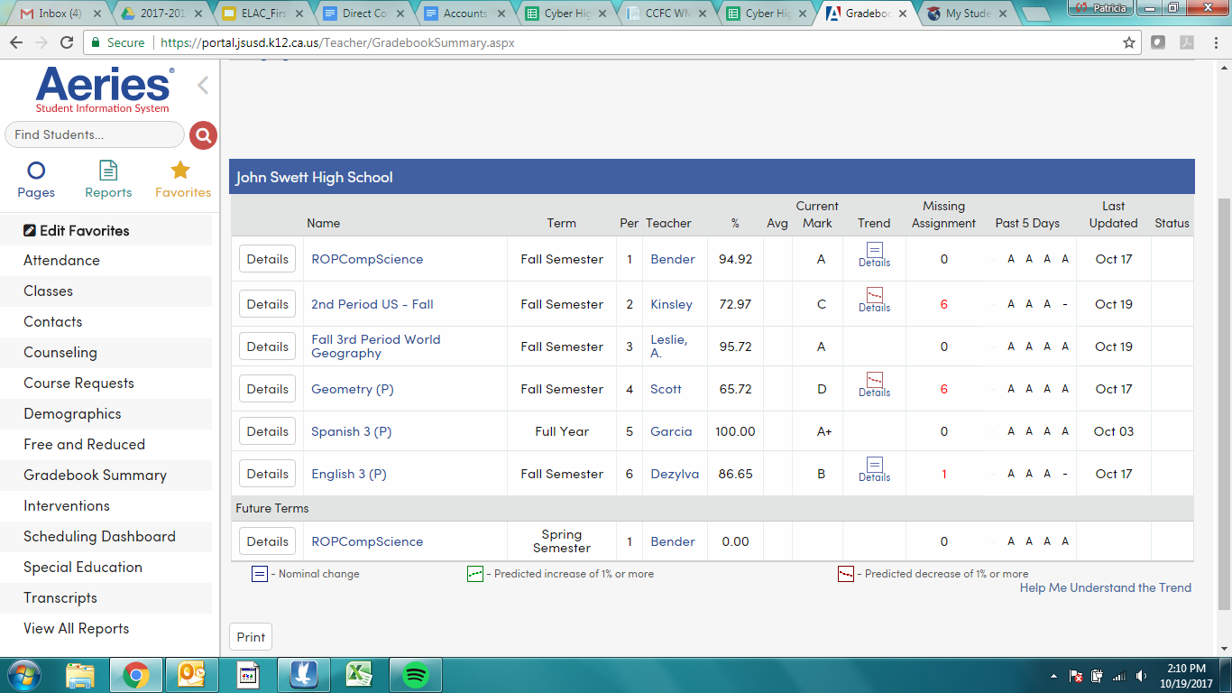
Aeries

Slide 18
Meals & Transportation

Slide 19
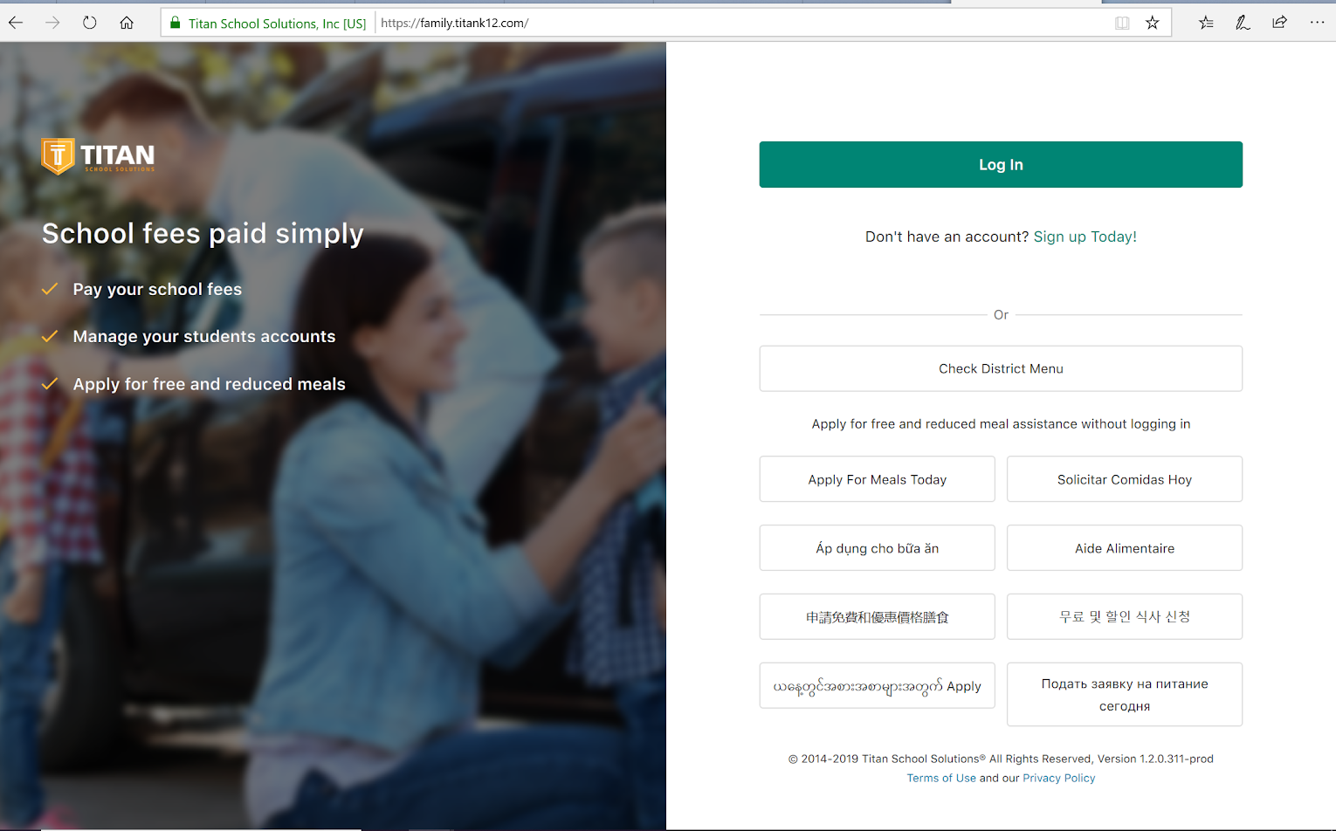
Meals & Transportation

Slide 20
Grade Reports

Slide 21
Distance Learning 2020
Need a computer/wifi?
Communication with teachers is important!

Slide 22
¿Questions?
DELAC: October 19, 2020
¿Questions or comments about today’s workshop?
Need help?

